Slide 2

Understanding MDS Perceptual Maps
With Guest Presenter
Geoff Fripp

Slide 3
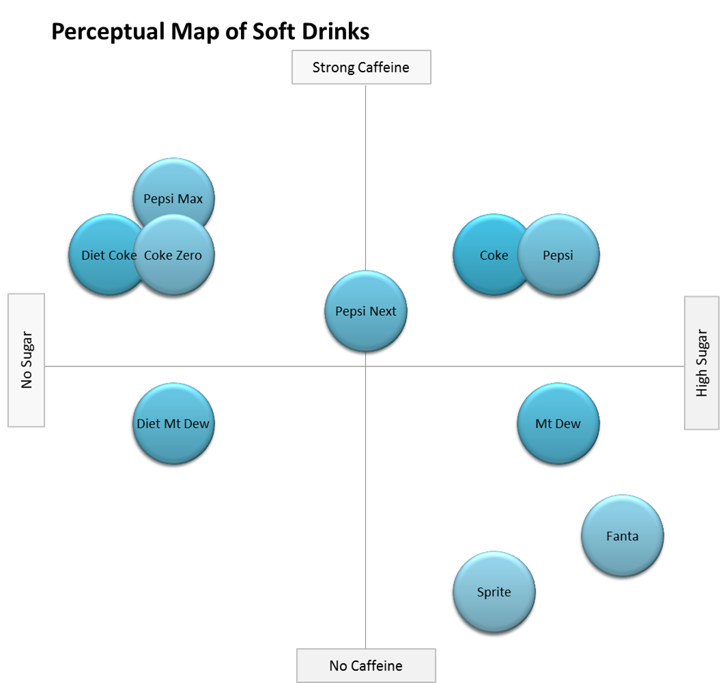
Introduction to MDS Maps
Overview of positioning
  Key aspects and why it’s important
Working with two-axis perceptual maps
  Tips on how to use
  Limitations

Slide 4
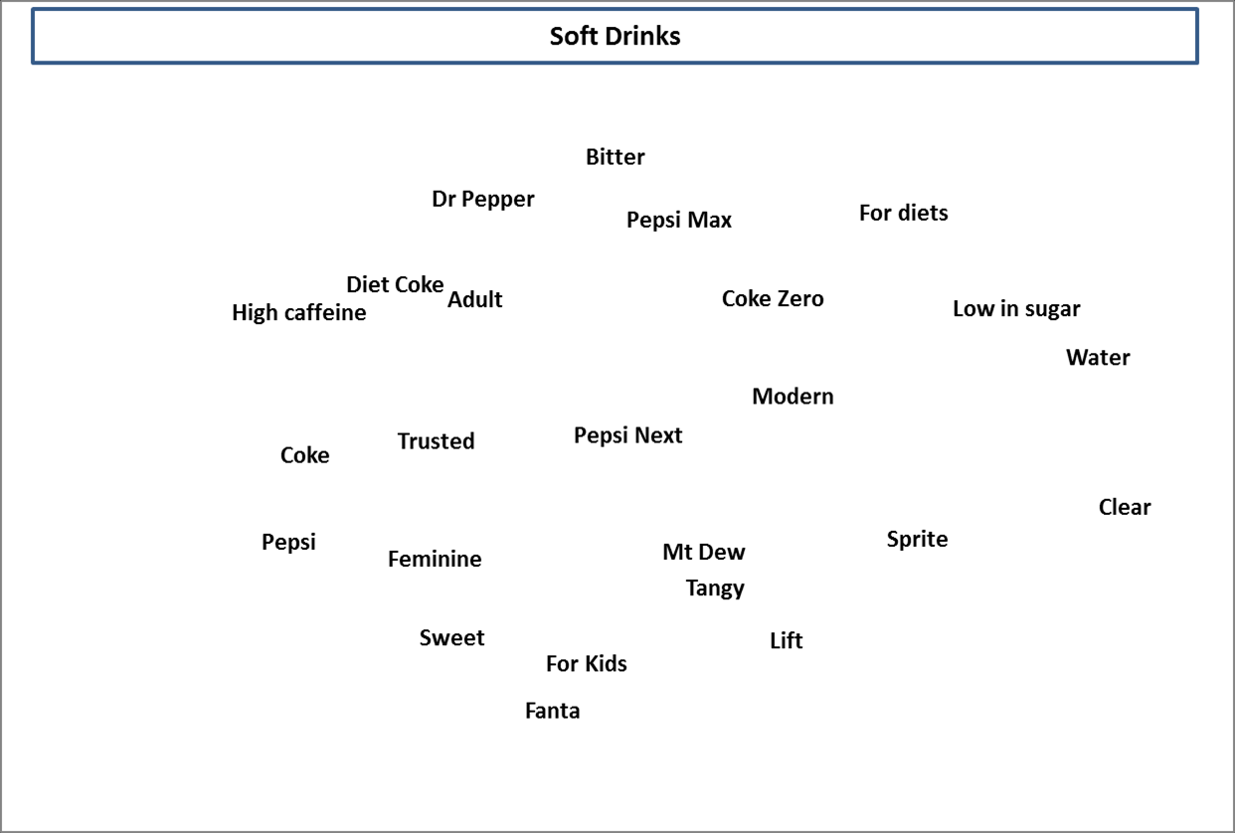
Introduction to MDS Maps
Multi-dimensional scaling (MDS) maps
  How to run them with the Excel template
  How to read these maps
  How to get market insights

Slide 5



Geoff Fripp
Marketing lecturer at the University of Sydney
  20+ years in corporate marketing:
    St. George Bank, Telstra, insurance and mutual banks
Co/author of marketing textbooks and case studies
Relevant educational sites
  perceptualmaps.com
  segmentationstudyguide.com
  clusteranalysis4marketing.com
Where I fit in…
Marketer
Analytical
Marketer
Specialist Marketing Analyst
Data Scientist

Slide 6
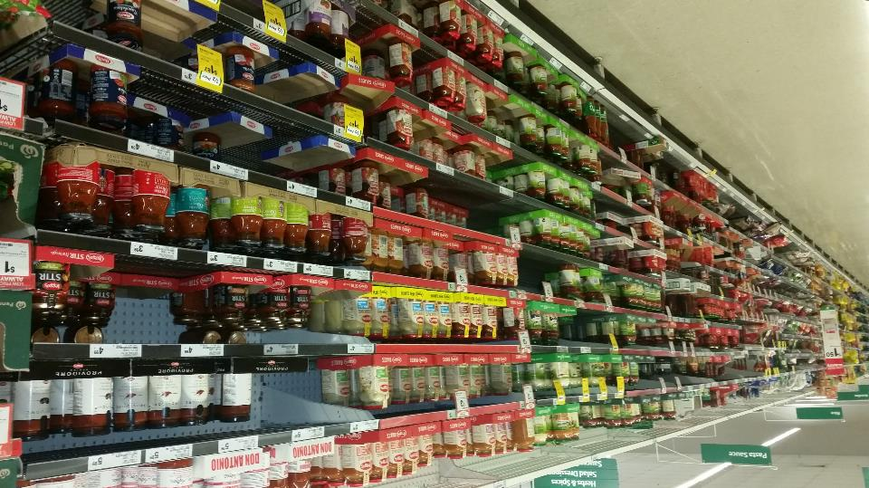
Positioning
How the brand/product is viewed by consumers
  Their assessment, opinion, understanding, attitude
What are its key benefits and/or product attributes?
As perceived in comparison to competing products
Should be clear, distinctive, and competitive-based and provide value to consumers

Slide 7

Positioning should be Clear

Slide 8







Positioning should be Distinctive

Slide 9


Positioning should be Competitive
Notes:
Dollar Shave Club example

Slide 10

Positioning Analogy
Develop brands – based on strengths
Take market positions
Dominate market space
Minimize competitor incentive
Challenge indirect competitors

Slide 11


Two Dimensional Perceptual Maps
We are looking to visualise how consumers differentiate and choose between brands
???
???
We are mapping PERCEPTION, not desired positioning
We are using competing BRANDS and key attributes, known as determinant attributes

Slide 12
Perception is reality!!!
What is the best movie ever made?

Slide 13
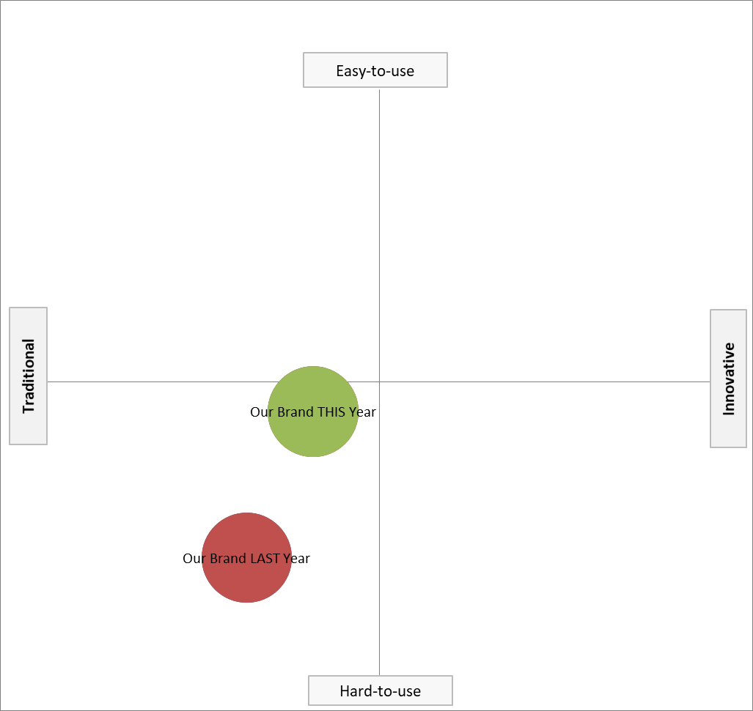
Reviewing a Perceptual Map
Impact of our marketing activities

Slide 14
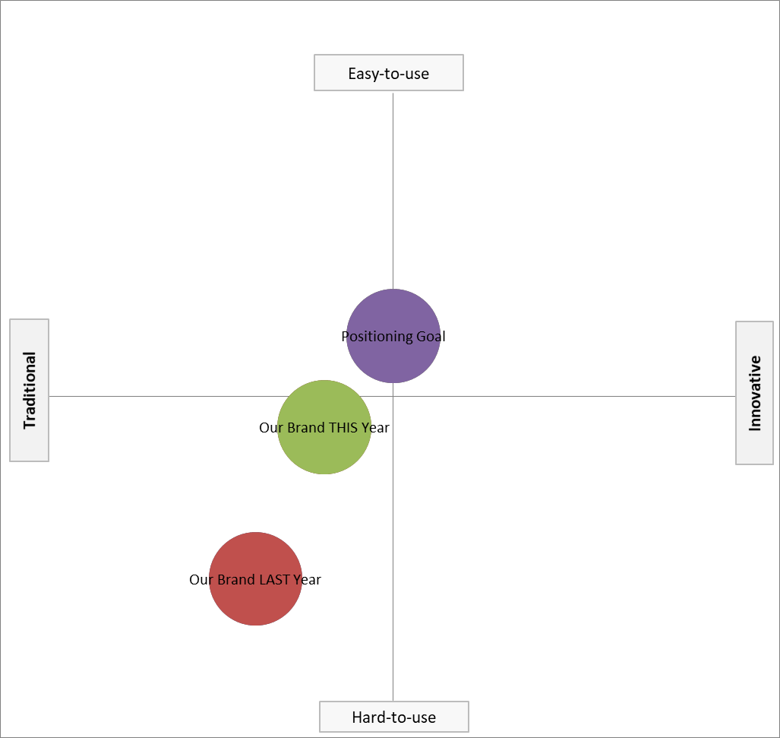
Reviewing a Perceptual Map
Impact of our marketing activities
Check reality

Slide 15
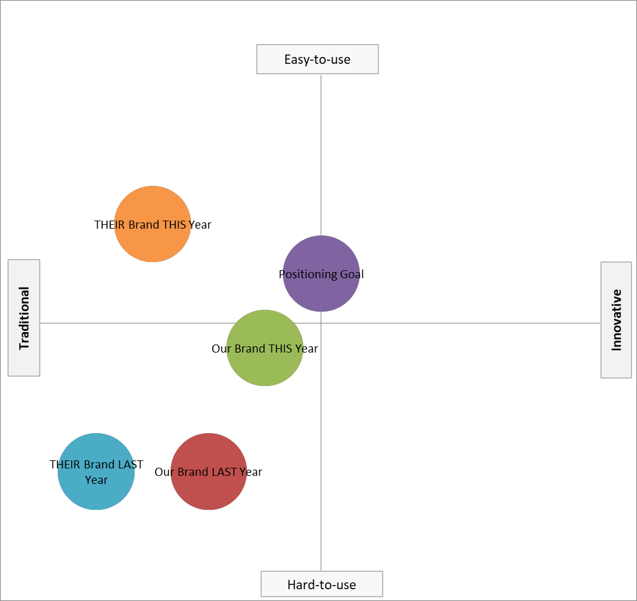
Reviewing a Perceptual Map
Impact of our marketing activities
Check reality
Impact of our competitors

Slide 16
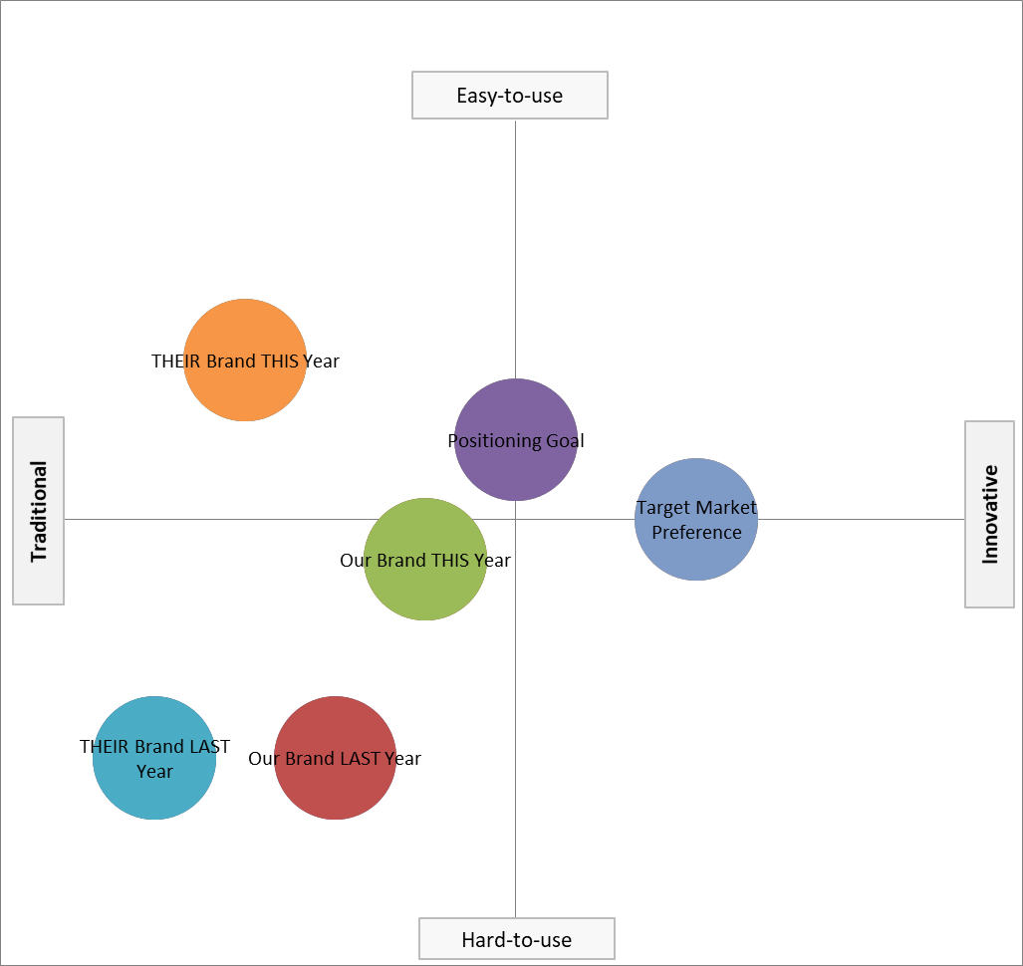
Reviewing a Perceptual Map
Impact of our marketing activities
Check reality
Impact of our competitors
Understand customers and preferences

Slide 17
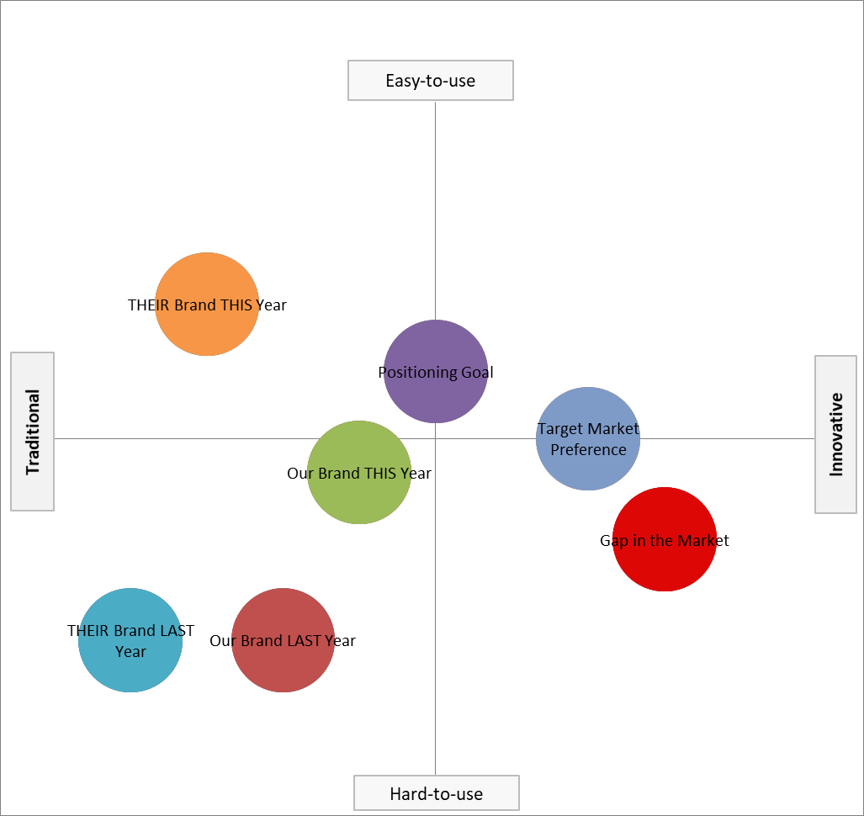
Reviewing a Perceptual Map
Impact of our marketing activities
Check reality
Impact of our competitors
Understand customers and preferences
Look for gaps and opportunities

Slide 18
Tips on Using 2-Axis Perceptual Maps
Drill down to market segments, not just the overall market
Likely different perceptions

Slide 19
Tips on Using 2-Axis Perceptual Maps
Drill down to market segments, not just the overall market
Track perception changes over time

Slide 20
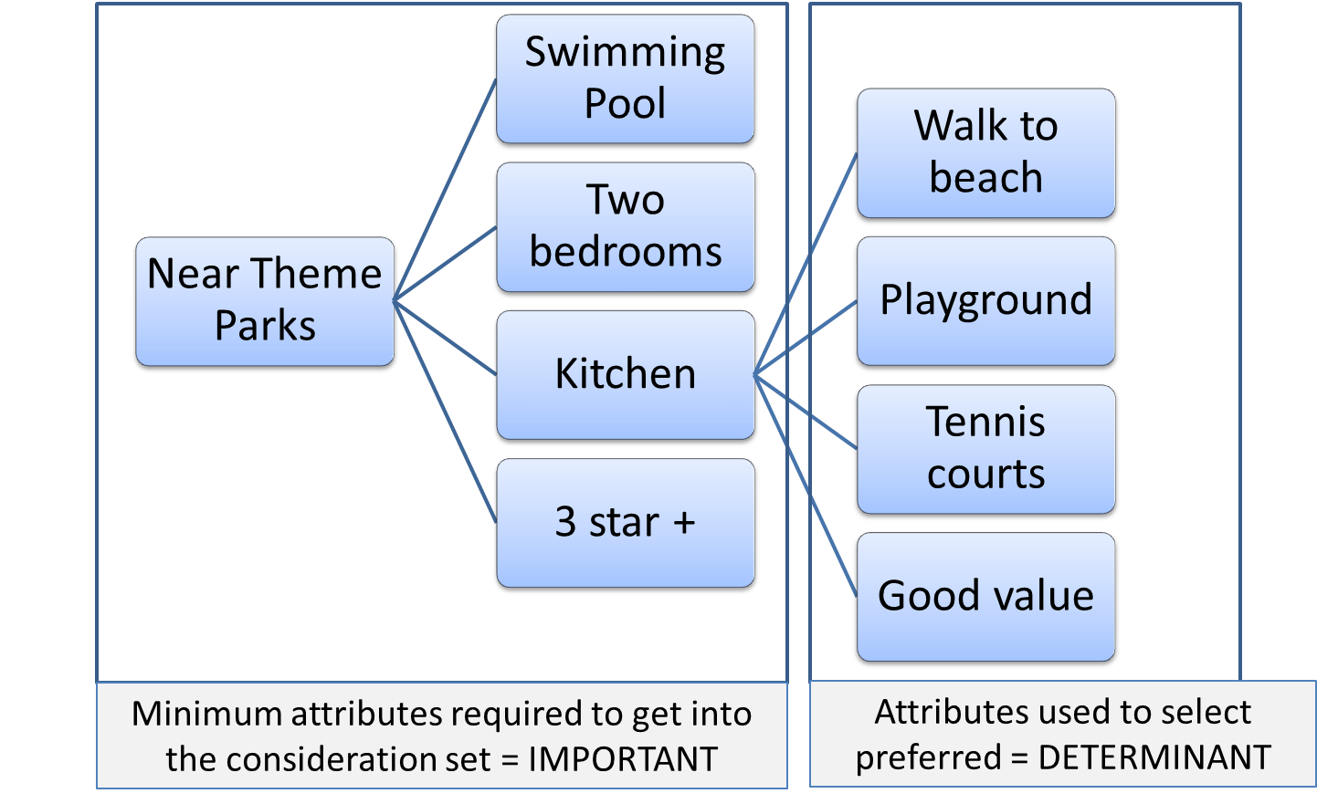
Tips on Using 2-Axis Perceptual Maps
Drill down to market segments, not just the overall market
Track perception changes over time
Use Determinant Attributes

Slide 21
Tips on Using 2-Axis Perceptual Maps
Drill down to market segments, not just the overall market
Track perception changes over time
Use Determinant Attributes
Review more than one perceptual map = you can use the fast mapping Excel template (with 25 attributes, you can produce 300 different maps

Slide 23
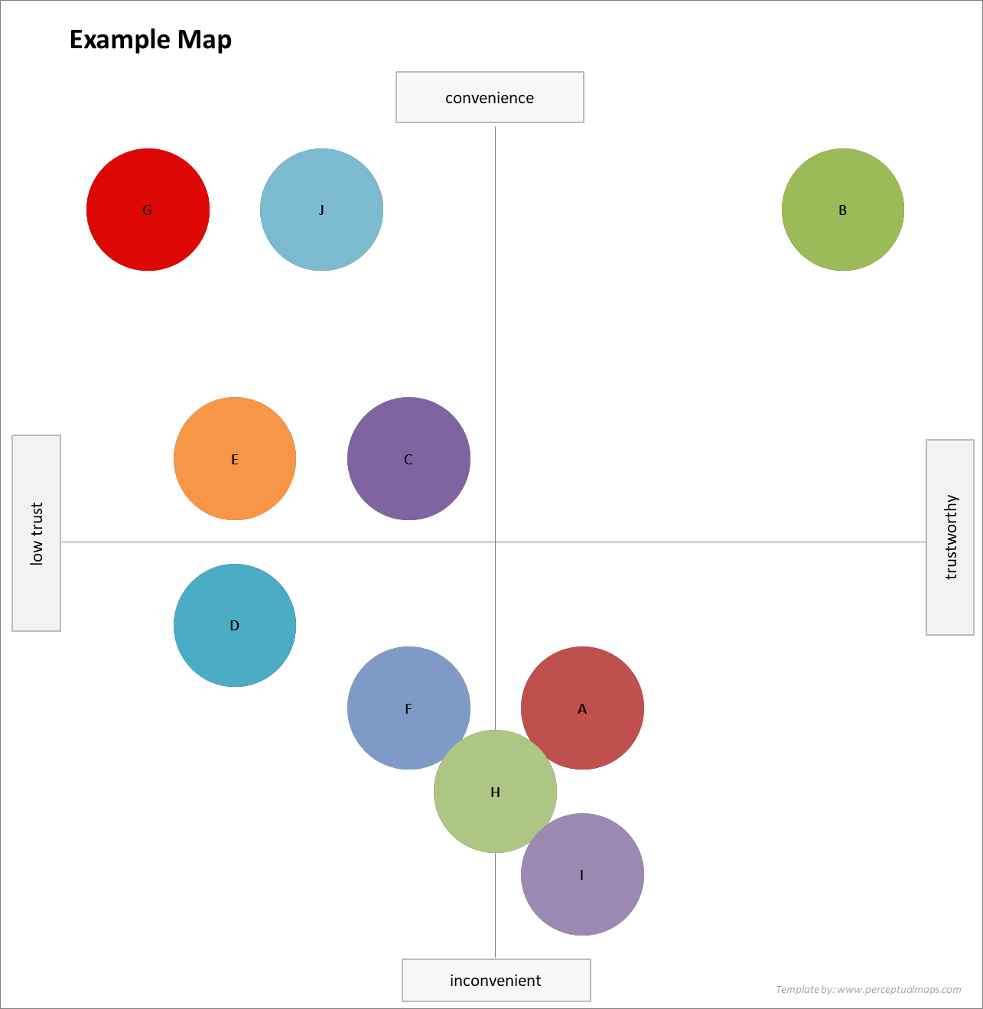
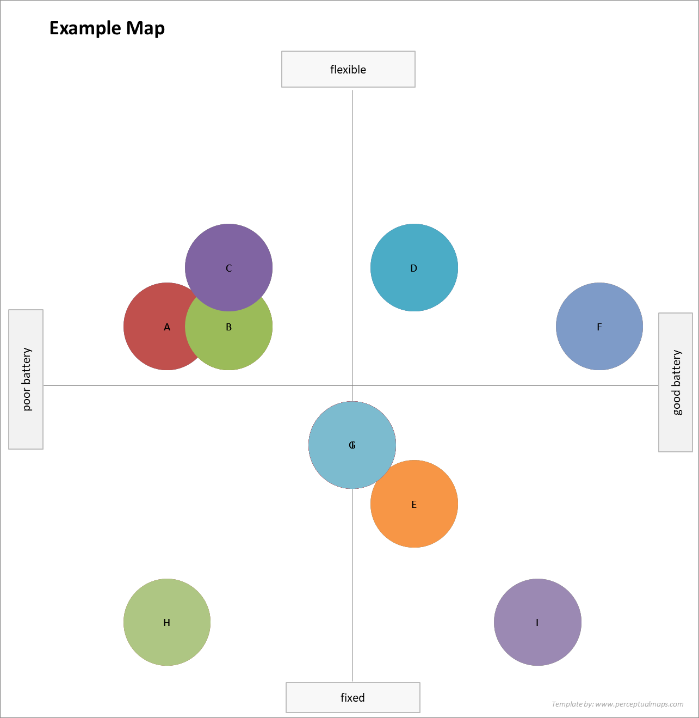
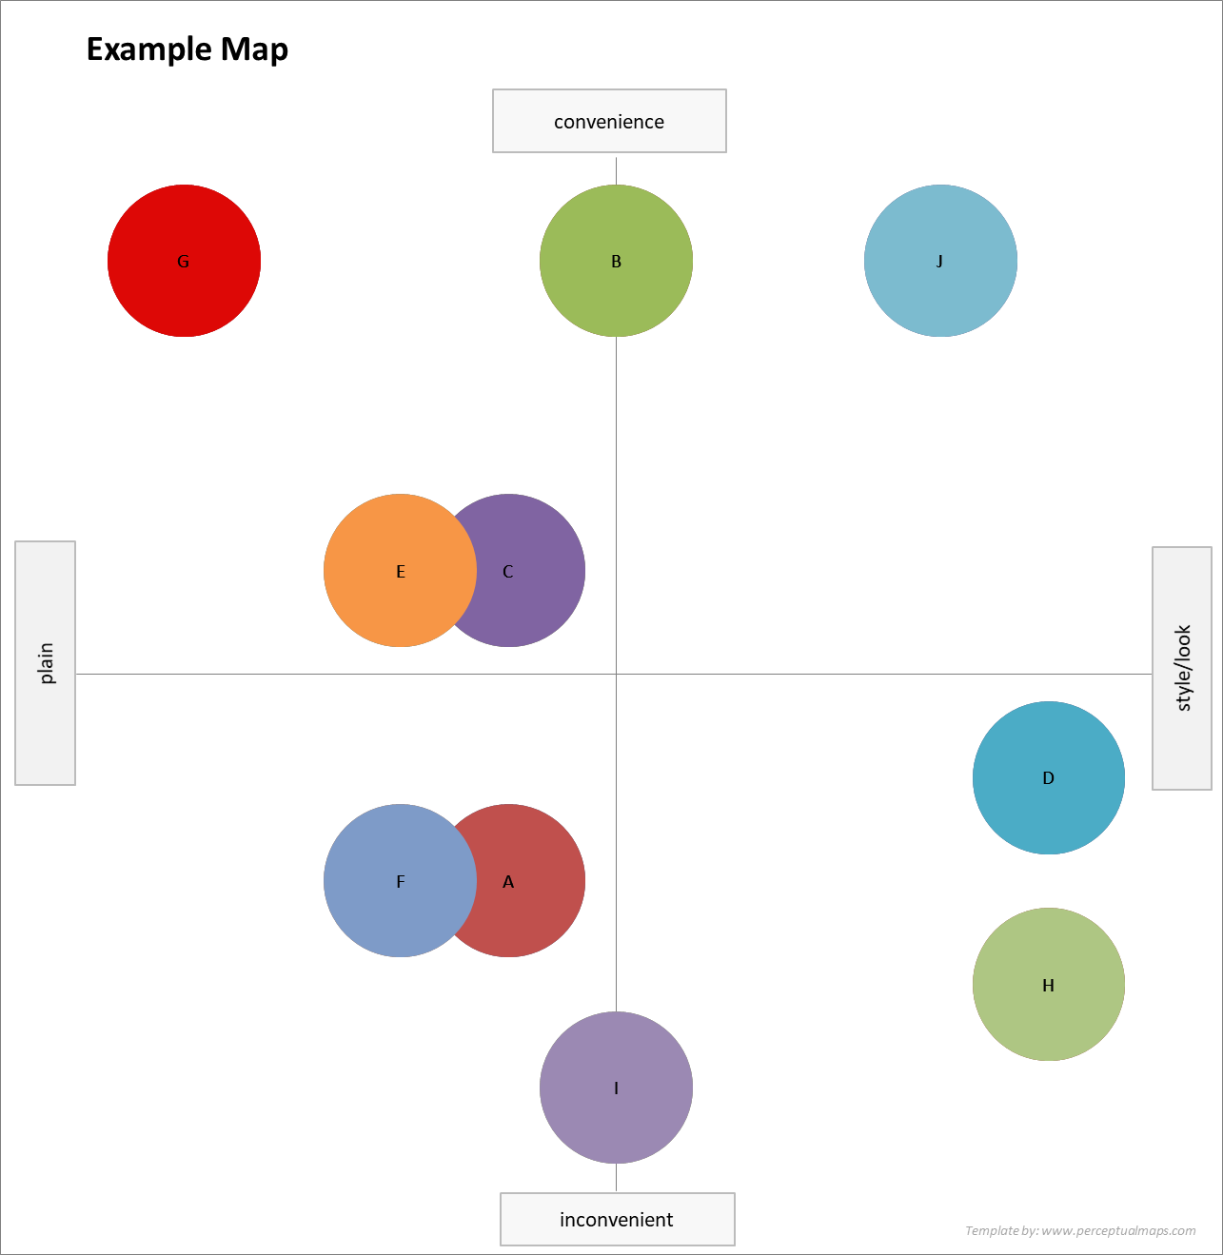
A new map is immediately and automatically produced – ideal for analysis and INSIGHTS

Slide 24
Tips on Using 2-Axis Perceptual Maps
Drill down to market segments, not just the overall market
Track perception changes over time
Use Determinant Attributes
Review more than one map
Don’t use price and quality together

Slide 25
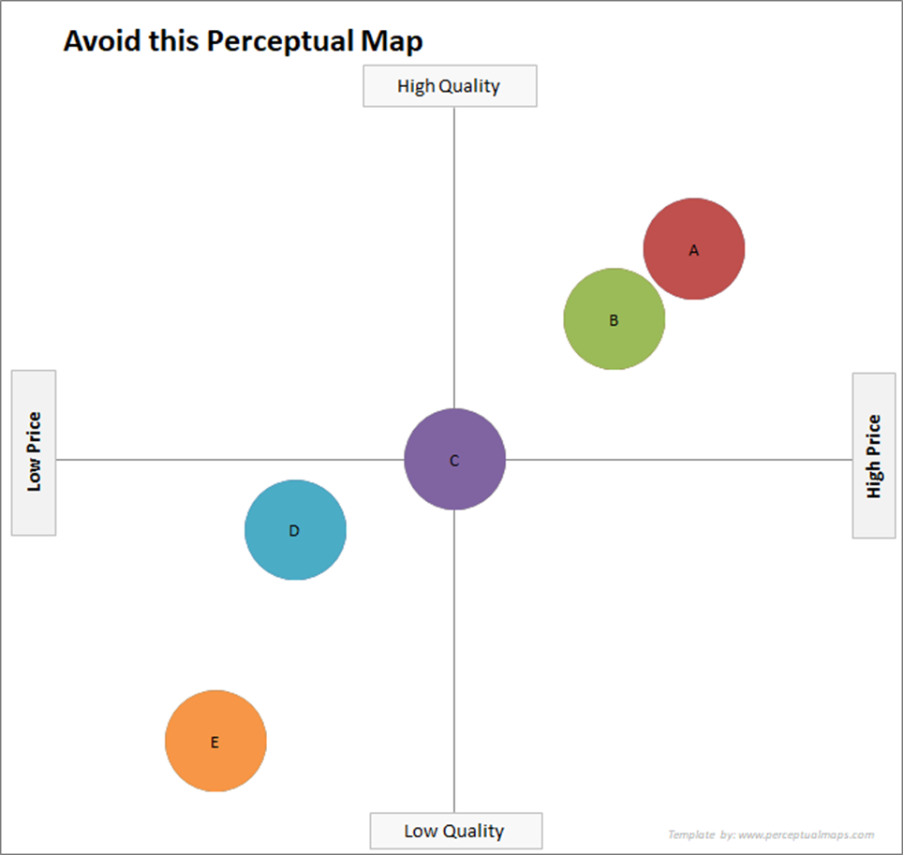
Price and Quality may be perceived as the same by consumers

Slide 26
Tips on Using 2-Axis Perceptual Maps
Drill down to market segments, not just the overall market
Track perception changes over time
Use Determinant Attributes
Review more than one map
Don’t use price and quality together
Watch out if your brand is in the middle of every map

Slide 27
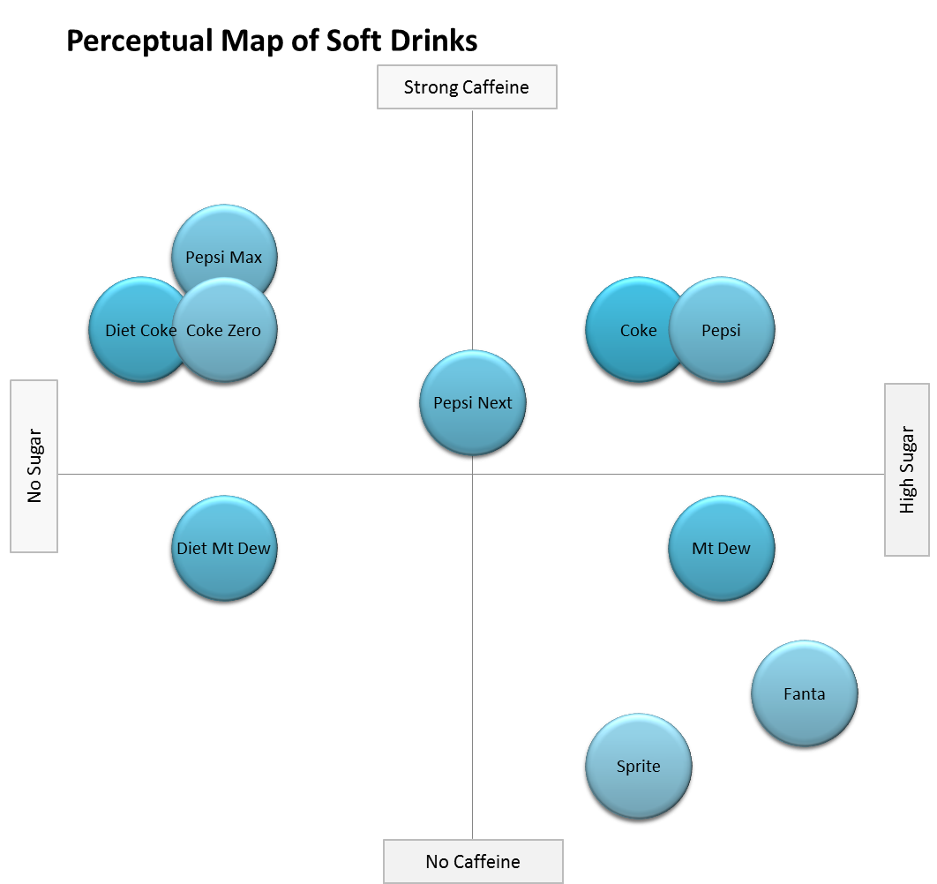
Indicates under positioning

Slide 28
Tips on Using 2-Axis Perceptual Maps
Drill down to market segments, not just the overall market
Track perception changes over time
Use Determinant Attributes
Review more than one map
Don’t use price and quality together
Watch out if your brand is in the middle of every map
Don’t be too ambitious pursuing market gaps

Slide 29
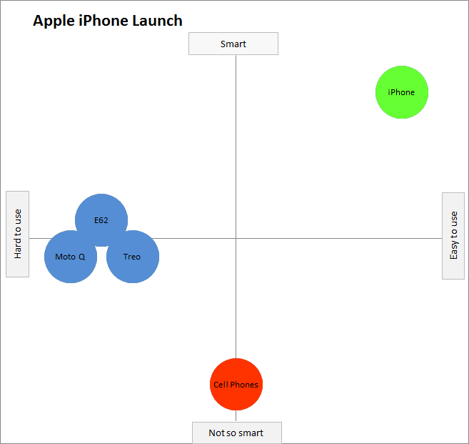

Slide 30
Limitations of 2-Axis Perceptual Maps
They simplify the consumer’s purchase decision down to two product attributes
  Using the “wrong” attributes could be misleading
They are purely descriptive, they provide limited new insight into the market
We cannot see how the market is interrelated
They do not clearly distinguish between owned and shared attributes
They do not ‘paint a picture’ of the overall market

Slide 31
Using the Excel Templates
Excel Tools you should have download…
Perceptual Map template for two-axes
Fast mapping template
MDS Perceptual Map template
We will be working with the MDS Perceptual Map template in this video
You need Excel to run
Can run on Apple Mac as well

Slide 32
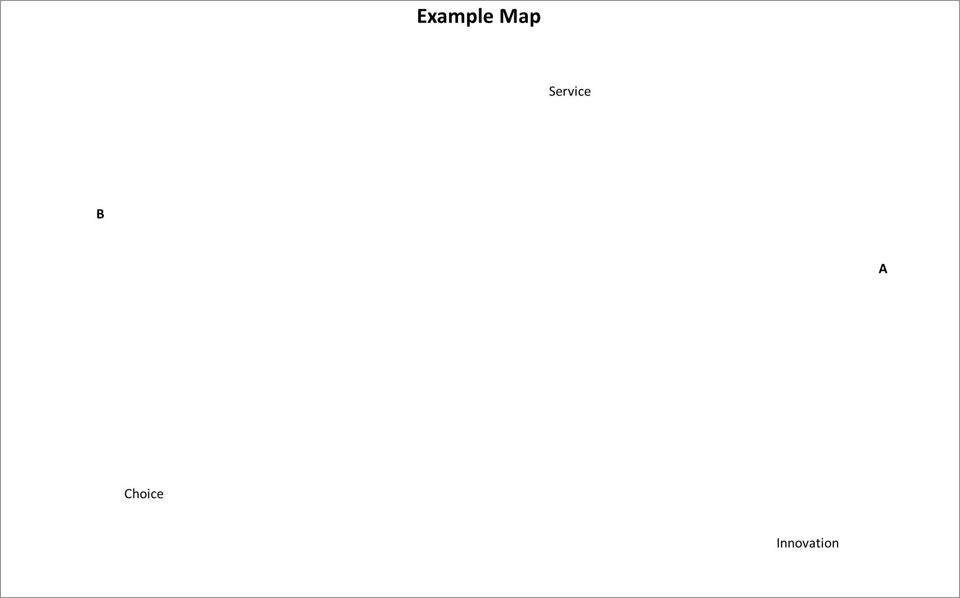
 | Brand A | Brand B
Service | 9 | 9
Choice | 1 | 5
Innovation | 5 | 1
IMPORTANT
MDS maps are interpreted differently to 2-axis maps
Shared
Owned
Owned

Slide 33
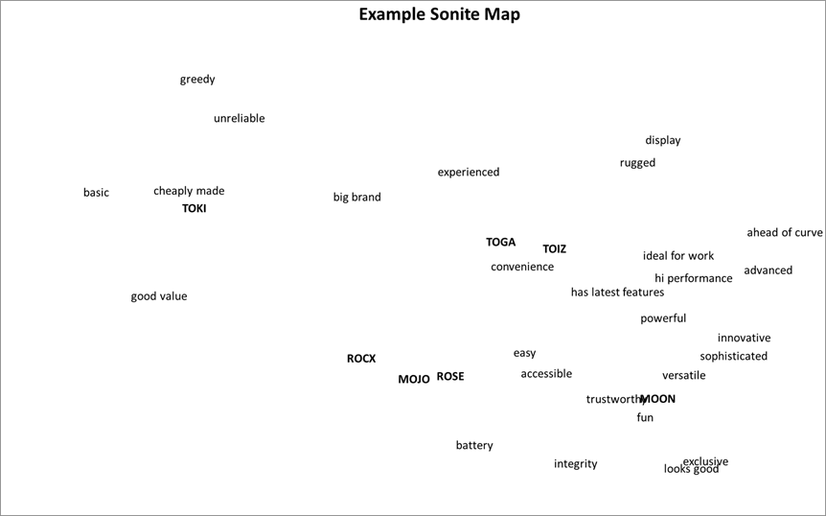
What does the template do?
It takes the perceptual map data
And works out the difference between each and every point
Brand ➔ attribute
Brand ➔ brand
Attribute ➔ attribute
Excel’s built-in “solver” then works out solution/s to maximize the correlation between the actual data and the plotted map data

Slide 34
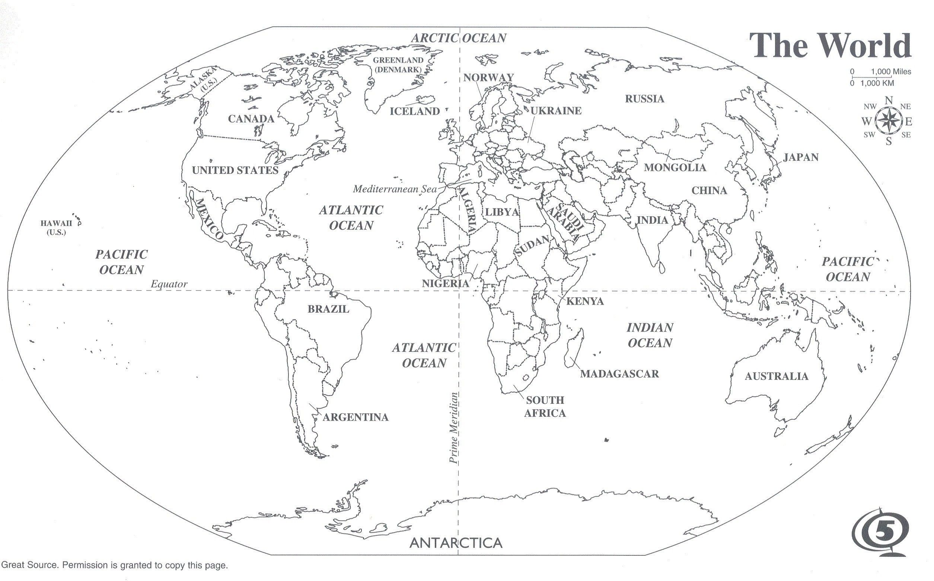
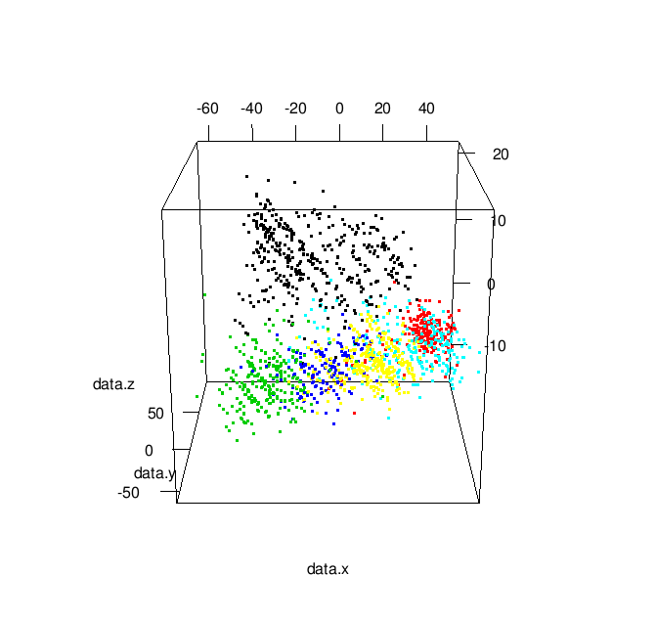
Map Variations?

Slide 35
Your turn to use the MDS Template with the data
There are some quick instructions to add Solver

Slide 36
Using the MDS Template with the Thinkers data

Slide 37
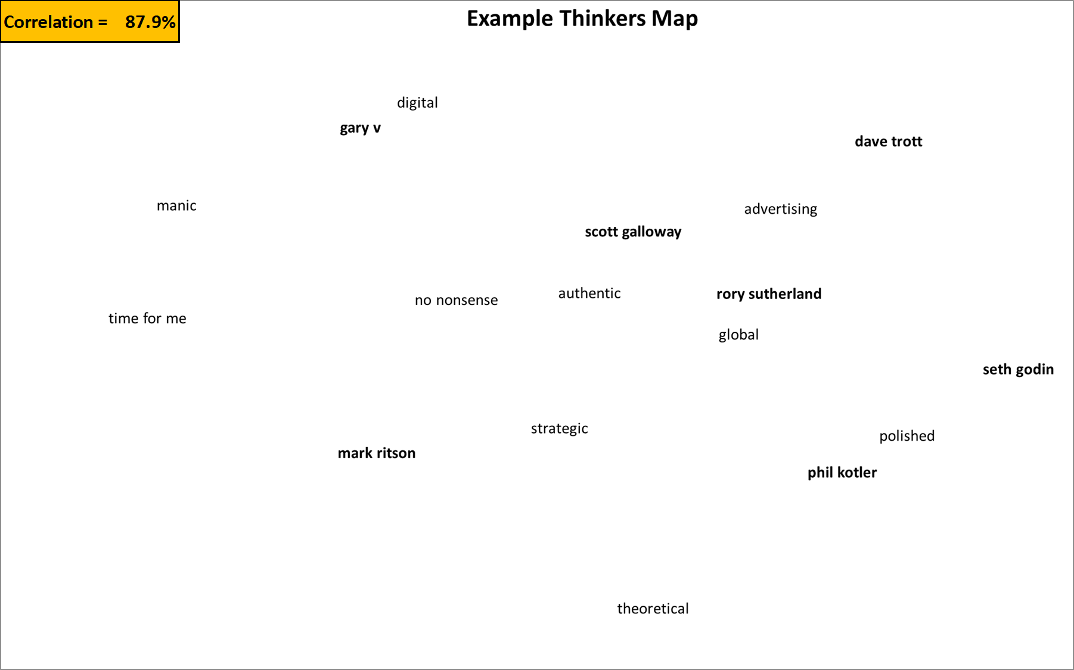
You may not get this exact map, but you will get something quite similar…

Slide 38
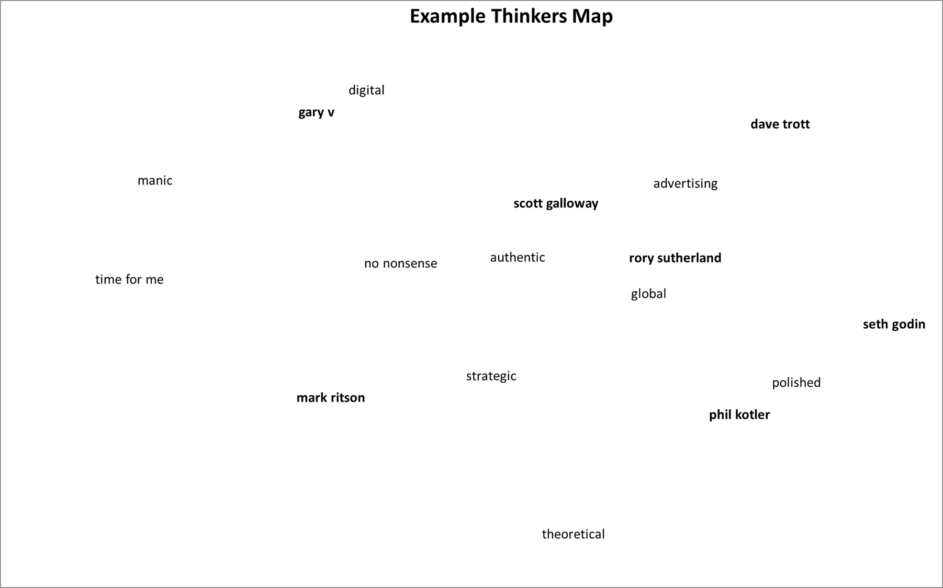
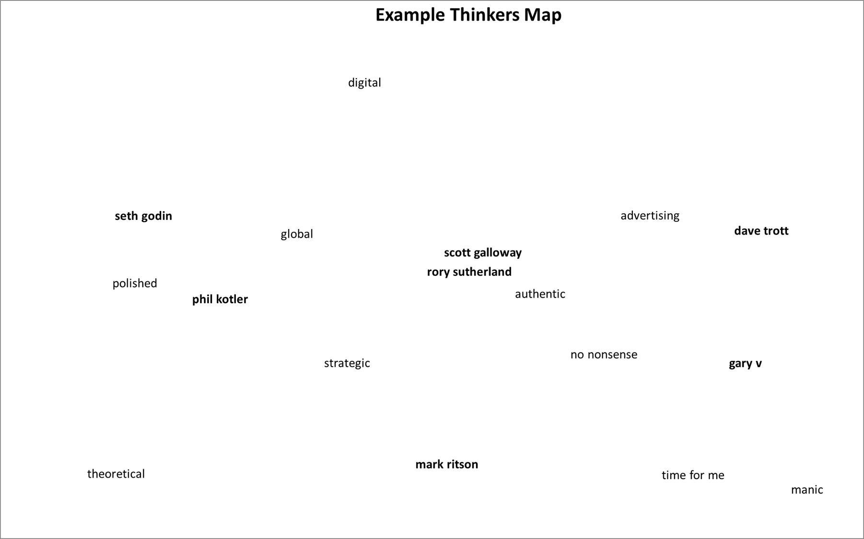
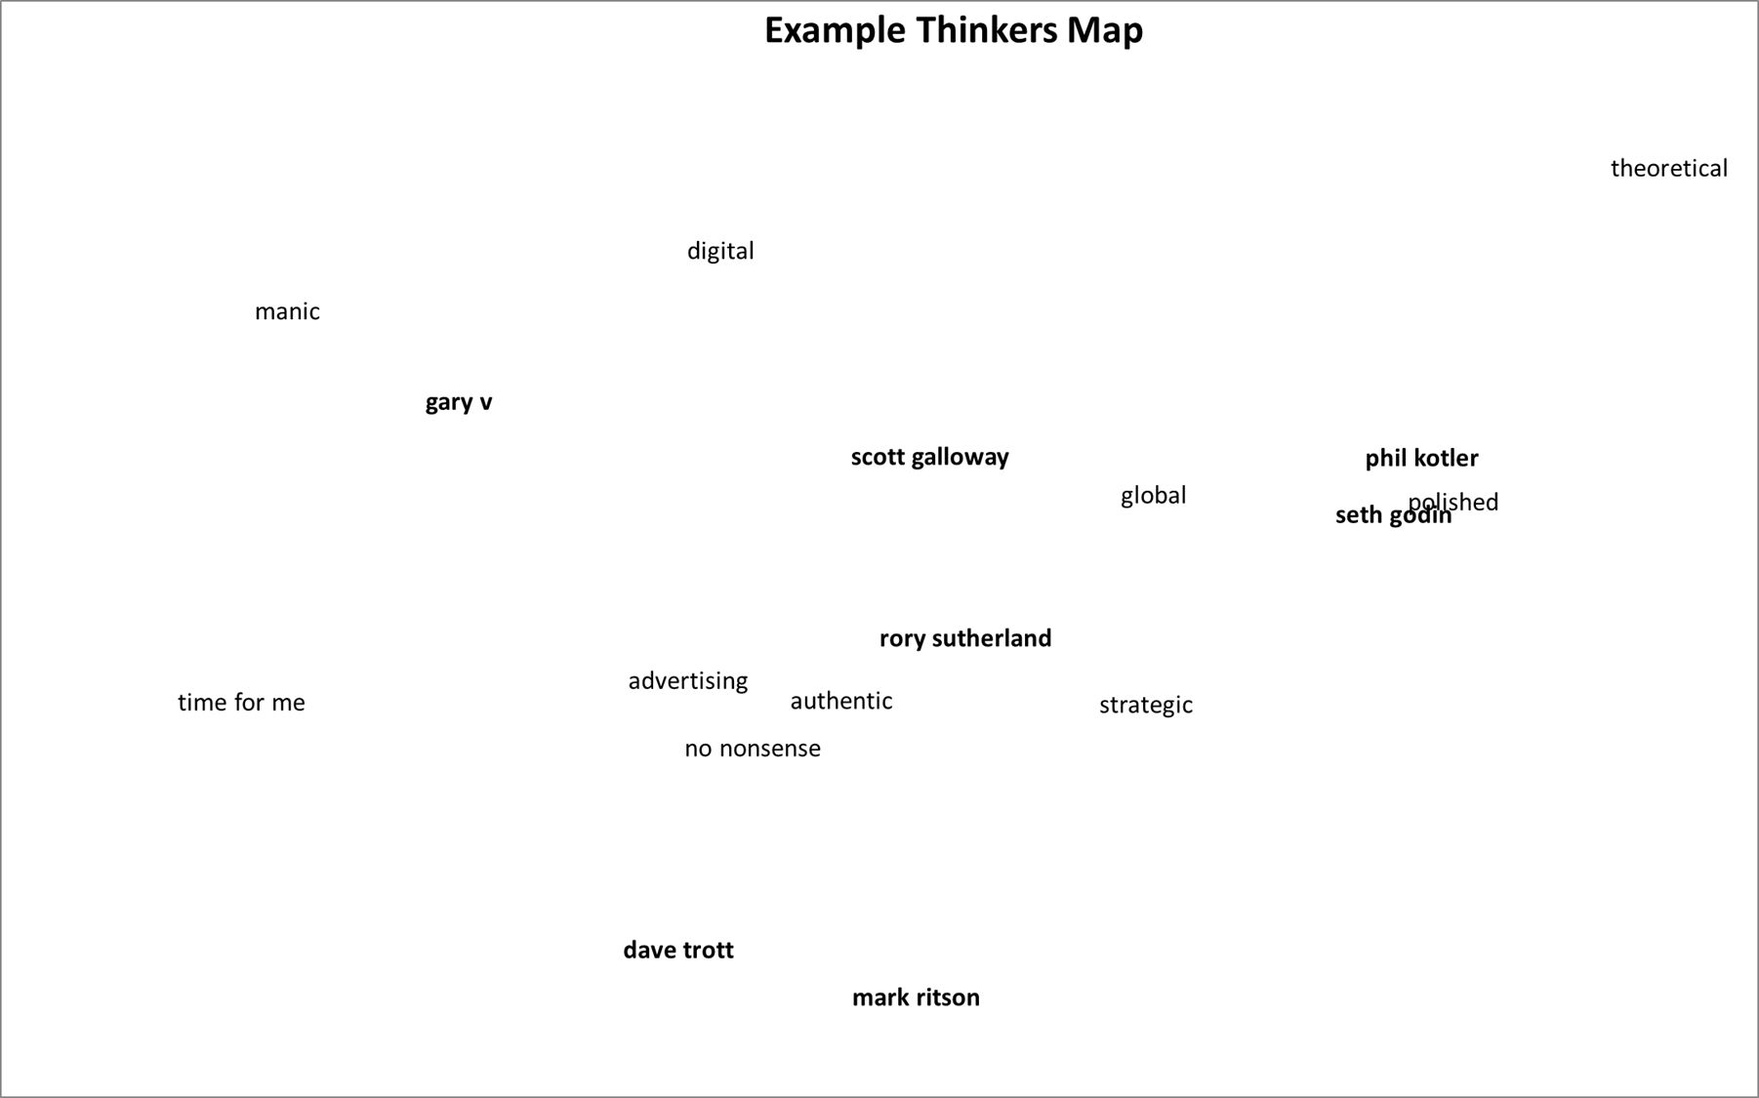
Map Variations?

Slide 39
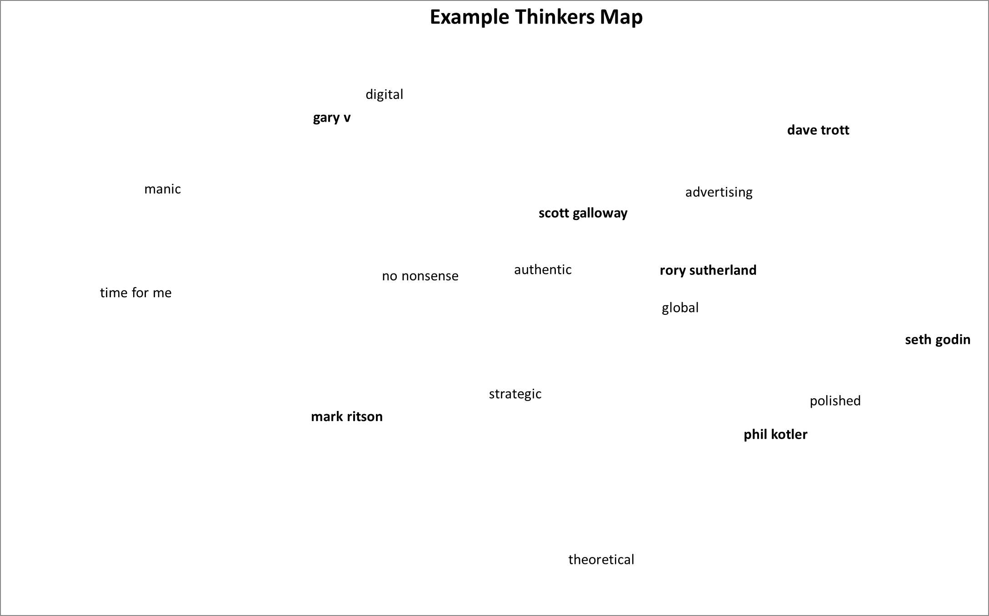
Can simplify a cluttered map

Slide 40
Identify competitor sets

Slide 41
Identify competitor sets

Slide 42
Identify related attributes, as perceived by consumers

Slide 43
Identify related attributes, as perceived by consumers

Slide 44
Identify OWNED and SHARED attributes
Mark Ritson

Slide 45
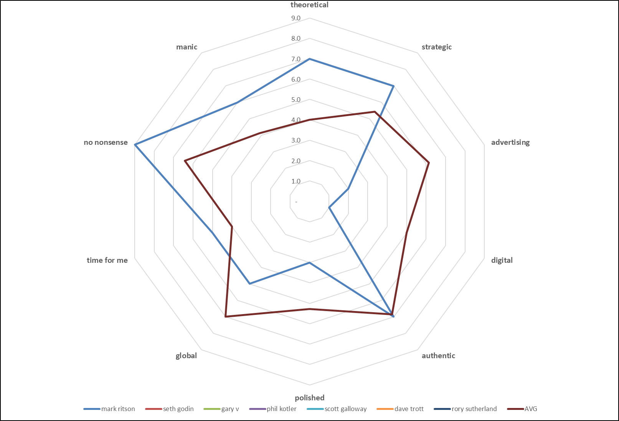
Data Check
Mark vs average brand

Slide 46
Identify OWNED and SHARED attributes
Gary V

Slide 47
OWNED and SHARED attributes
(between the two)

Slide 48
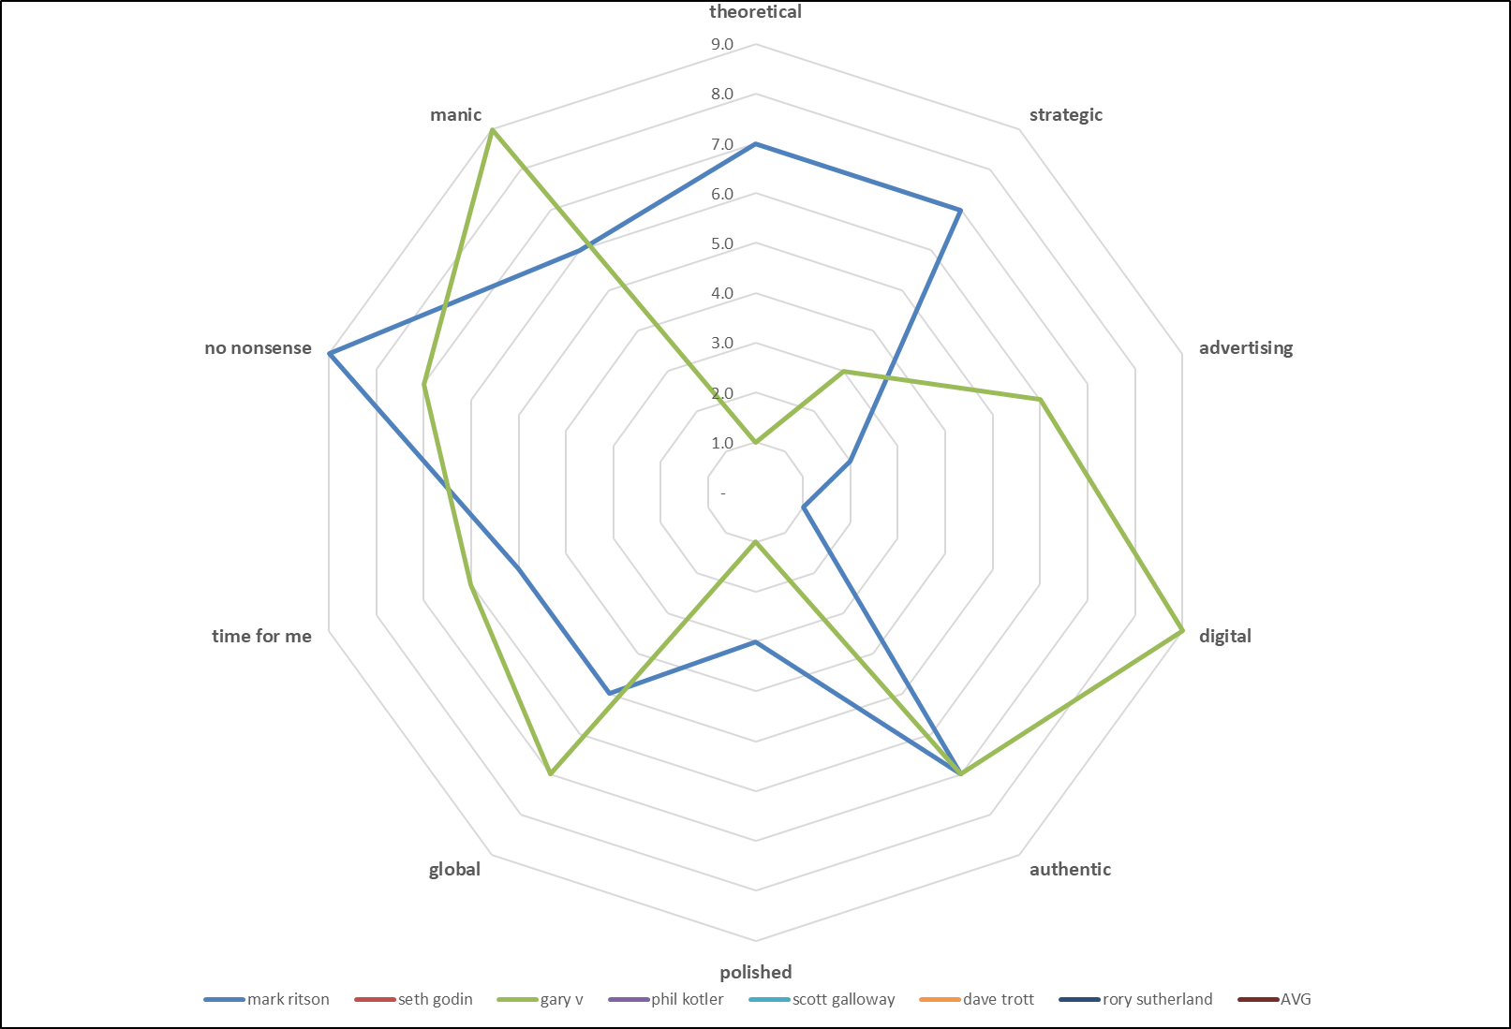
Data Check
Mark vs Gary V
Gary
Mark

Slide 49
Revised OWNED and SHARED attributes

Slide 50
Identify OWNED and SHARED attributes
Scott Galloway

Slide 51
Only one clearly OWNED, almost all are SHARED attributes, but with unique combinations

Slide 52
Look for More Insights
Analyzing MDS Maps
Descriptive
Exploratory

Slide 53
Identify dimensions
This is a more challenging, and more subjective part, of the analysis
Identifying dimensions
Labelling them
Using them in decisions
Takes time, knowledge of the market, and some map variations may help
Notes:
Firstly we can identify dimensions – this is challenging and subjective

Slide 54
Identify dimensions
MANIC
REAL
POLISHED

Slide 55
Identify dimensions
MANIC
REAL
PRACTICAL
POLISHED
APPLIED THEORY
PURE THEORY

Slide 56
Identify dimensions
CURRENT
TRADITIONAL
MANIC
REAL
PRACTICAL
POLISHED
APPLIED THEORY
PURE THEORY

Slide 57
Identify dimensions
CURRENT
TRADITIONAL
MANIC
FOR ME
FOR ALL
REAL
PRACTICAL
POLISHED
APPLIED THEORY
PURE THEORY

Slide 58
Other insights
Connected and disconnected attributes

Slide 59
Other insights
Incongruent attributes

Slide 60
Other insights
Selection of attributes

Slide 61
Other insights
CURRENT
TRADITIONAL
MANIC
REAL
POLISHED
Correlated attributes

Slide 62
MDS Analysis RECAP
Identify competitor sets
Identify related attributes, as perceived by consumers
Identify OWNED and SHARED attributes
  = overall positioning ➔ points-of-parity and points-of-difference
Identify dimensions and label/describe
Look for other insights
  Correlated dimensions
  Incongruent attributes
  Appropriate attribute selection
IMPORTANT: Compare back to the data to confirm your analysis

Slide 63
Quick Note: MDS vs Cluster Analysis
MDS maps rely on related connections
  Brands vs brands
  Brands vs attributes
  Attributes vs attributes
If you are looking to classify or summarise a market:
  Segments, key customers, key players
Then MDS is probably not the tool, you are looking for clusters/segments
So check out… www.clusteranalysis4marketing.com

Slide 64
Understanding MDS Perceptual Maps
Presented by
Geoff Fripp
Notes:
Hope that adds to your tools for marketing

