Slide 1
Using the MDS Template with the Sonites data
Notes:
OK – let’s use the template with the Sonite/Sim data

Slide 2
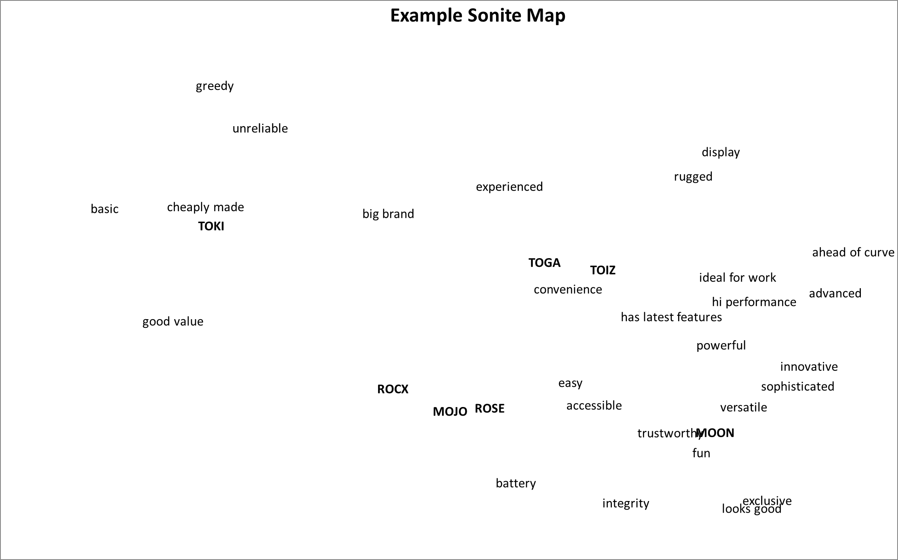
You may not get this exact map, but you will get something quite similar…
Notes:
Here is a map that I have run – you should have something similar

Slide 3

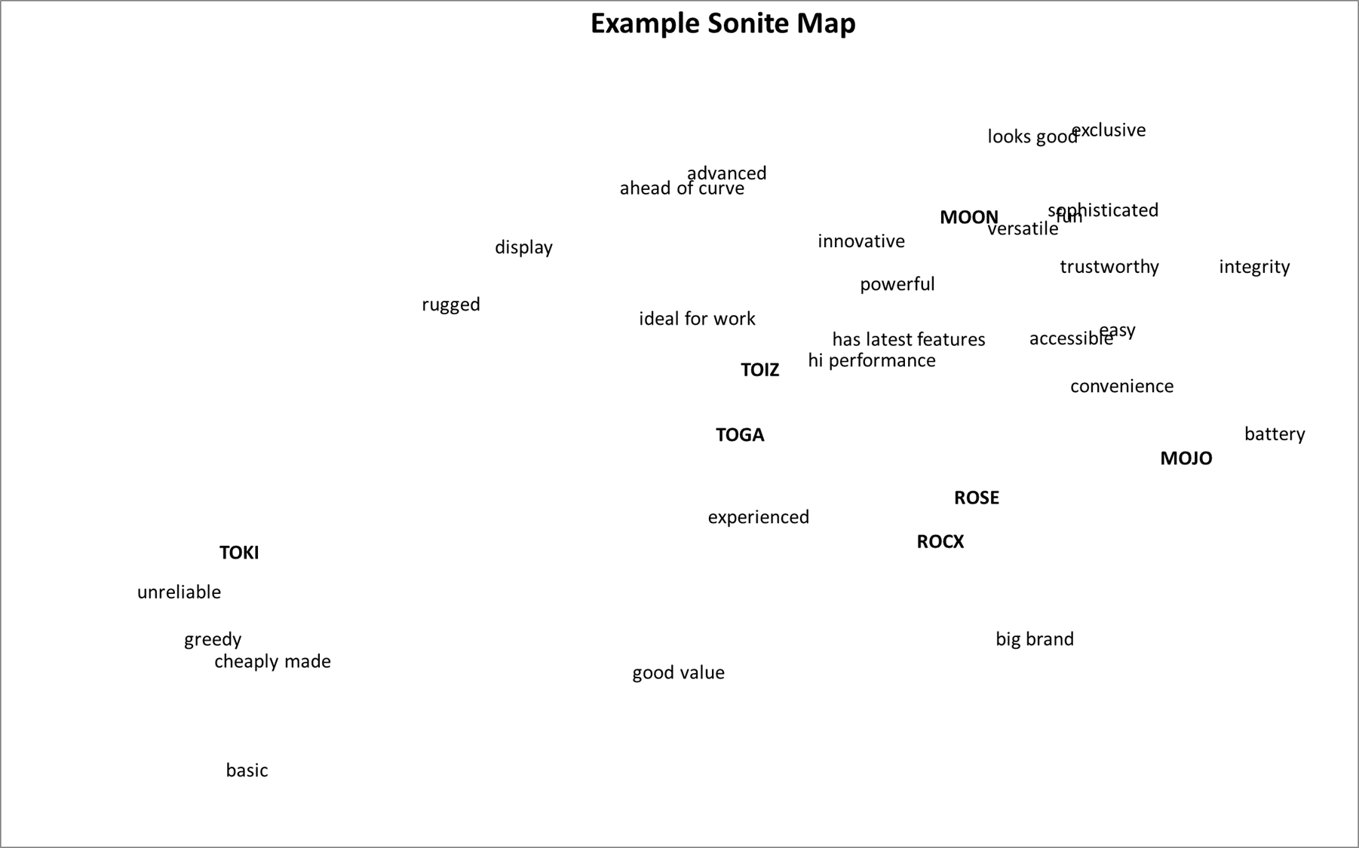
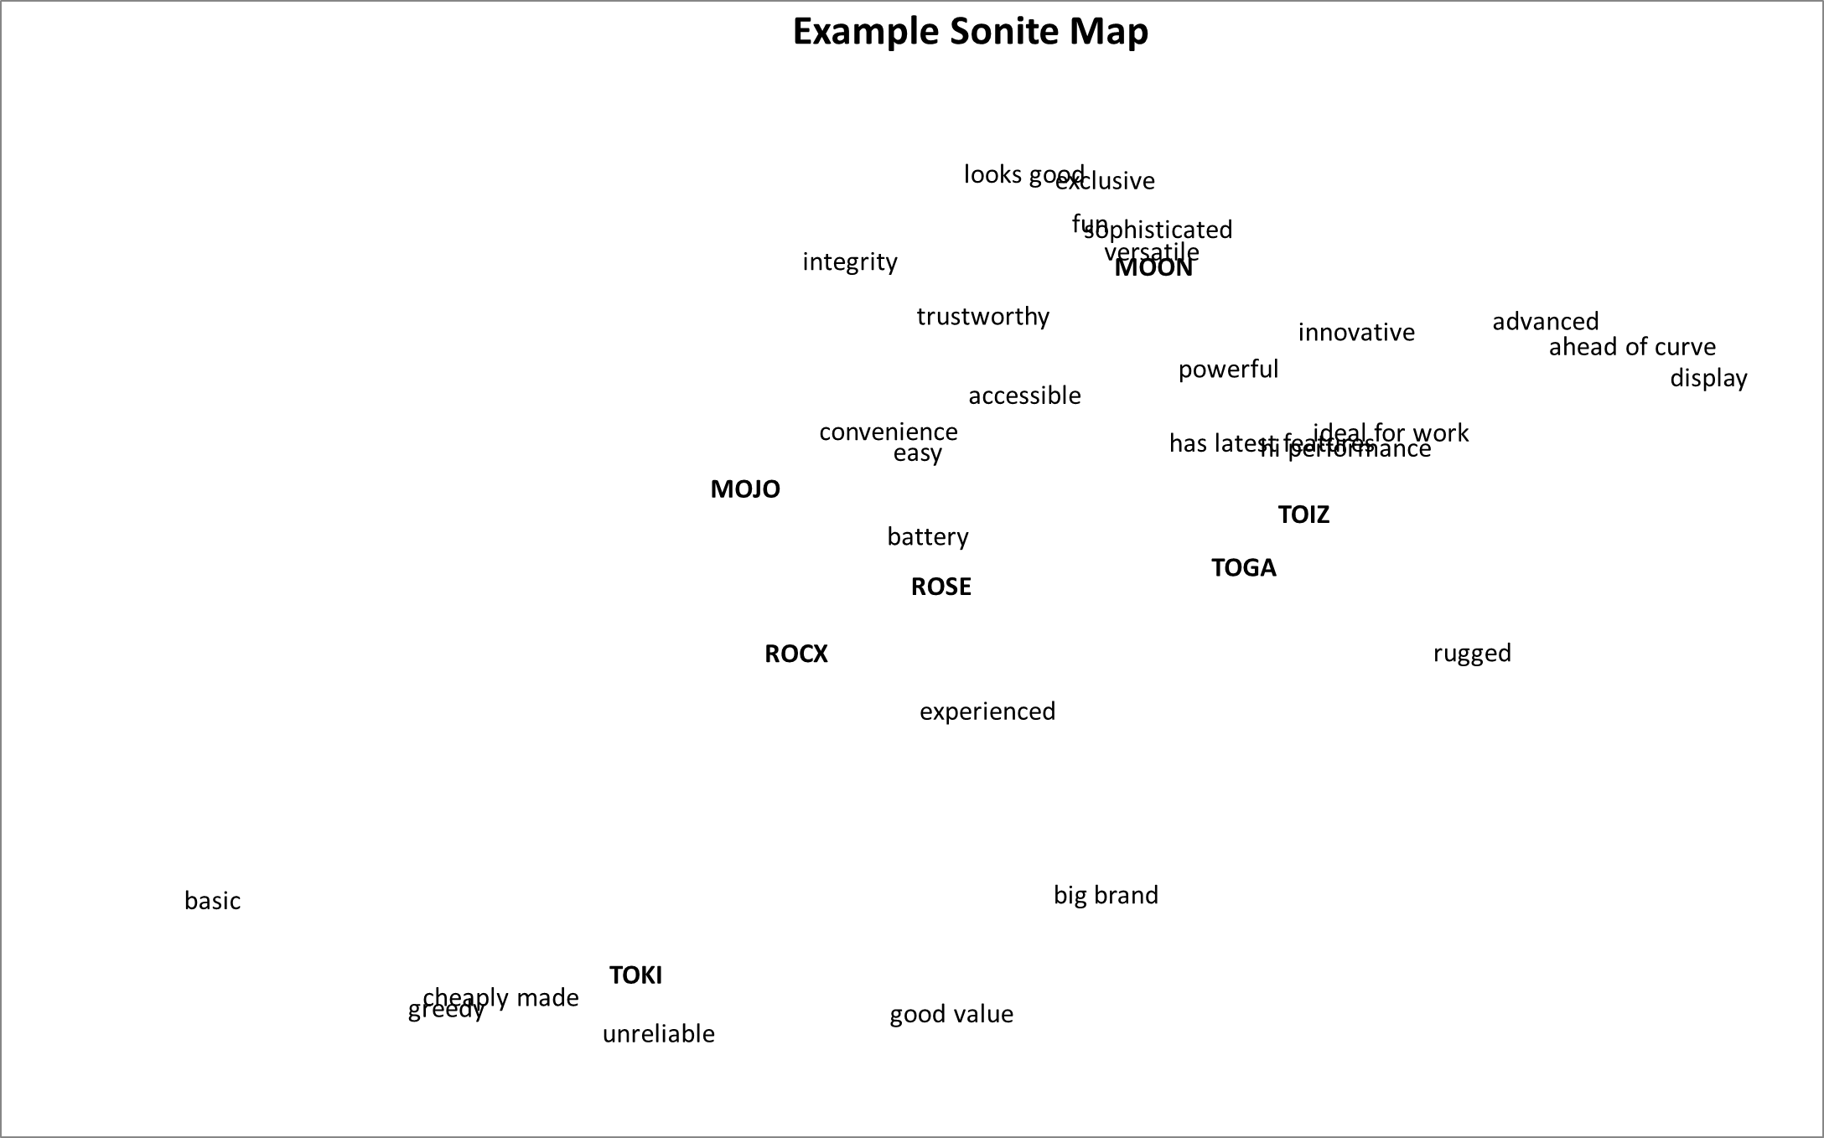
Map Variations?
Notes:
You might get a slightly different map – here are three maps with the same data…

Slide 4
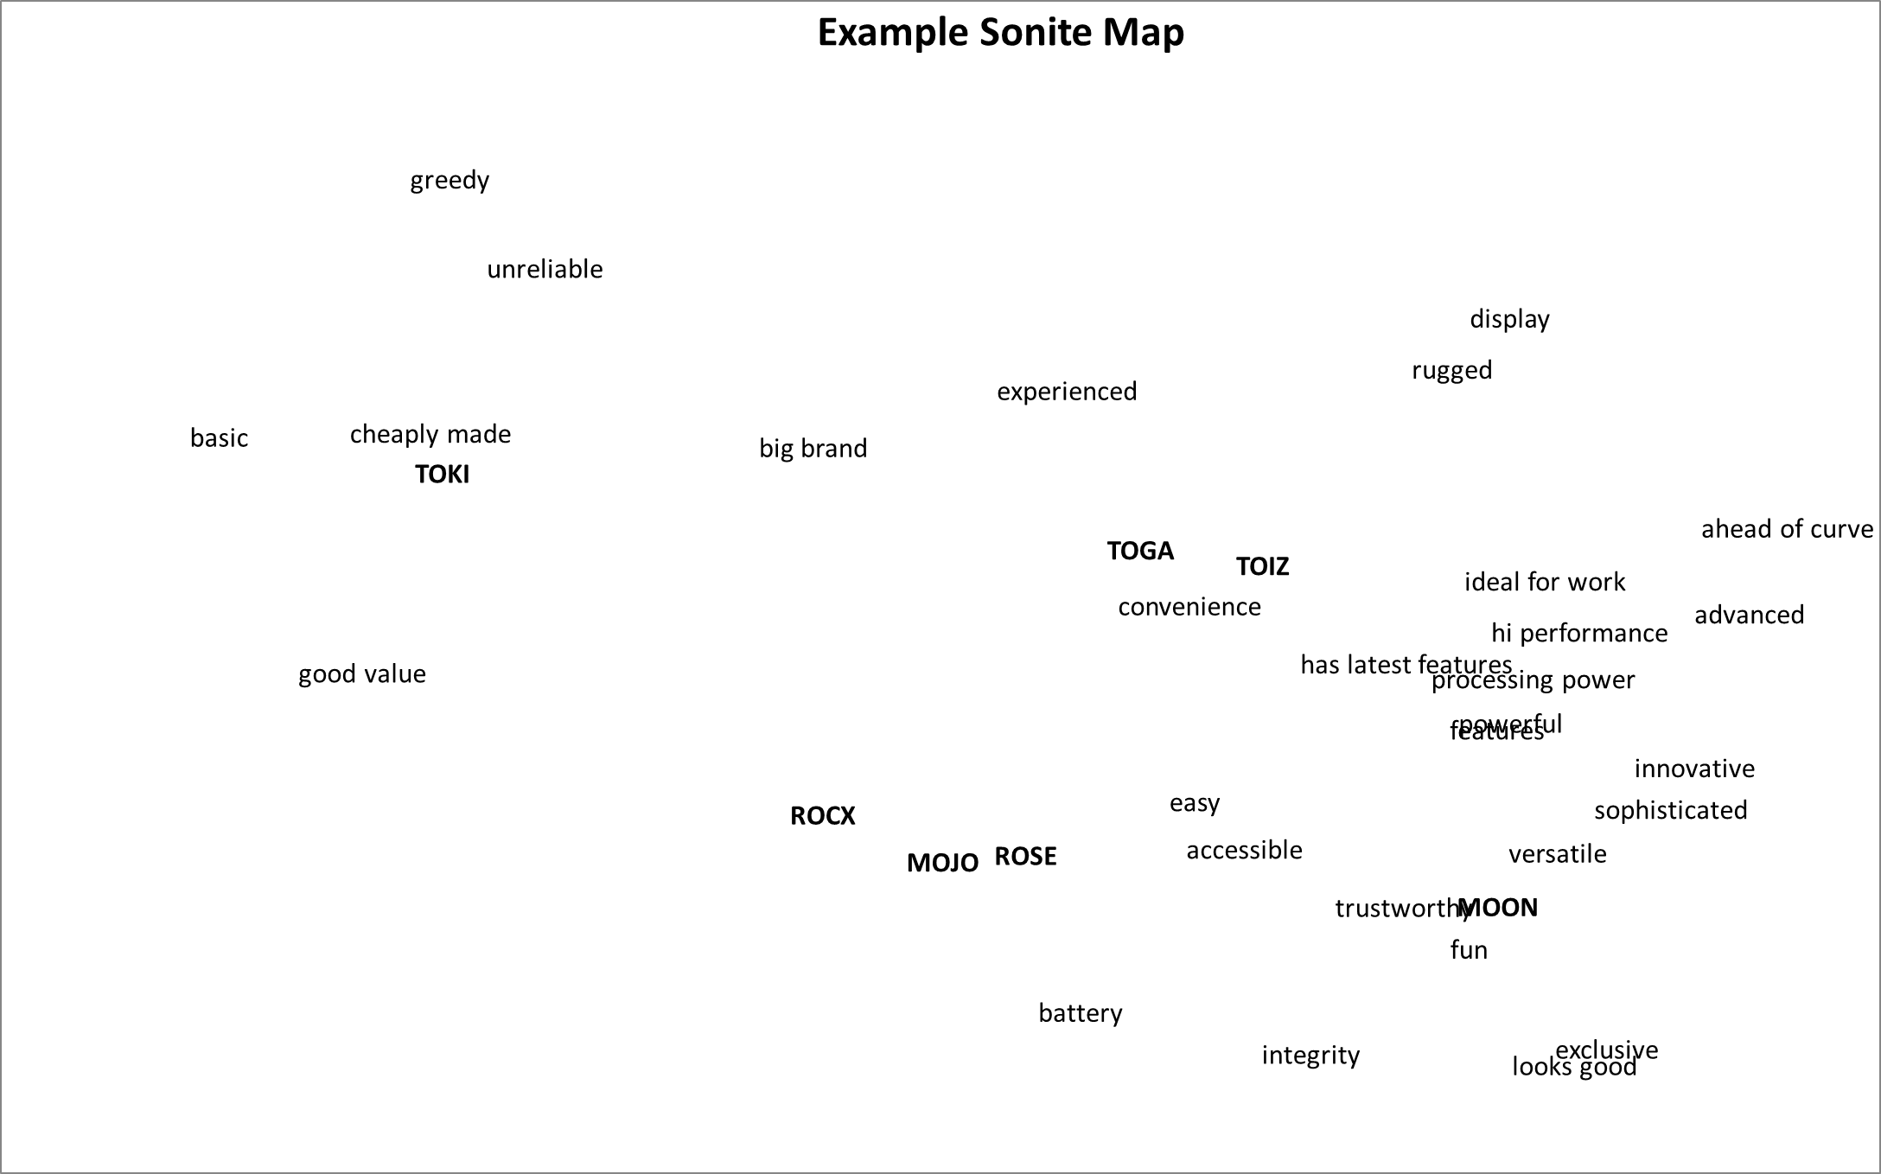
Can simplify a cluttered map
Notes:
Optional Step 6 to take some attributes off the map – to make it clearer

Slide 5
Notes:
It would look like this as a result…

Slide 6
Identify competitor sets
Notes:
Firstly, we can identify competitor sets

Slide 7
Identify competitor sets
Notes:
As you can see – TOKI and MOON are opposites, TOGA + TOIZ are similar, as are the other three

Slide 8
Identify related attributes, as perceived by consumers
Notes:
We can do the same thing with attributes

Slide 9
Identify related attributes, as perceived by consumers
Notes:
For example, these attributes appear to be interrelated

Slide 10
Identify related attributes, as perceived by consumers
Notes:
And we can continue the process and identify even more related attributes

Slide 11
Identify OWNED and SHARED attributes
Notes:
As discussed earlier, we can identify owned and shared attributes

Slide 12
Identify OWNED and SHARED attributes
TOKI
Notes:
Let’s start with TOKI and their associated attributes

Slide 13
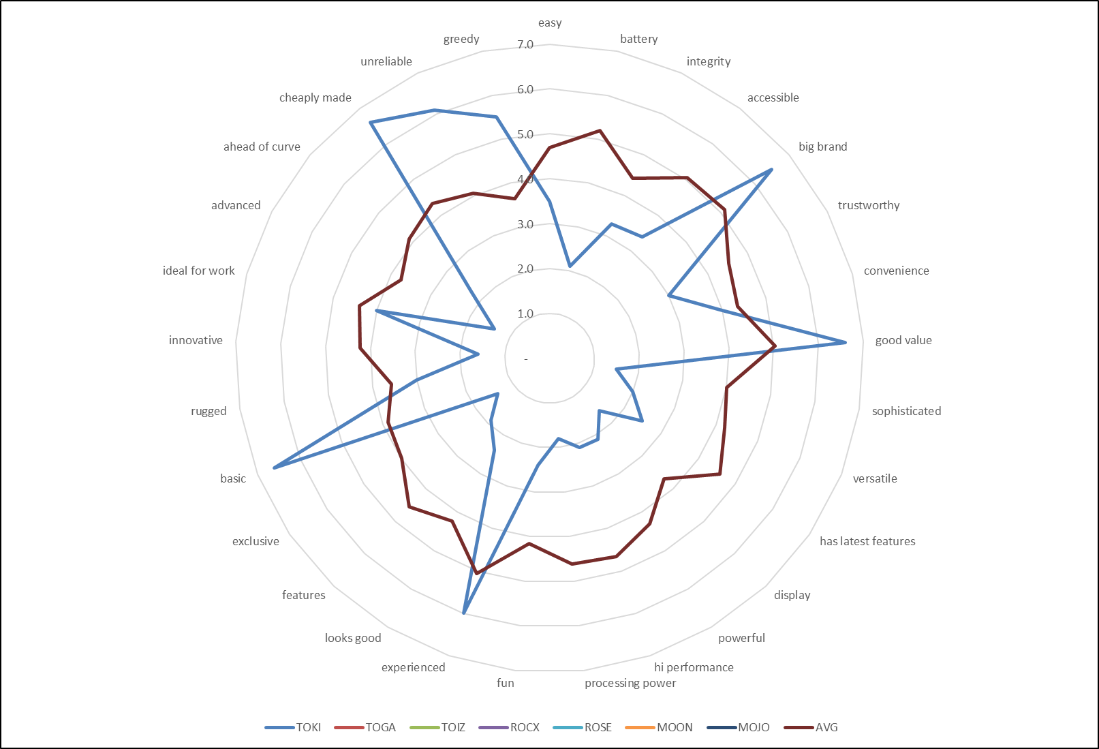
Data Check
TOKI vs average brand
Notes:
Here is the radar chart that you have in the template – where we can confirm our analysis

Slide 14
Identify OWNED and SHARED attributes
TOKI vs TOIZ & TOGA
Notes:
Now we do the same thing with TOGA and TOIZ

Slide 15
Identify OWNED and SHARED attributes
TOKI vs TOIZ & TOGA
Notes:
Here we can now see the owned/shared attributes for TOKI, where red = shared

Slide 16
Identify OWNED and SHARED attributes
MOJO vs ROSE
Notes:
Let’s now look at the difference between MOJO and ROSe

Slide 17
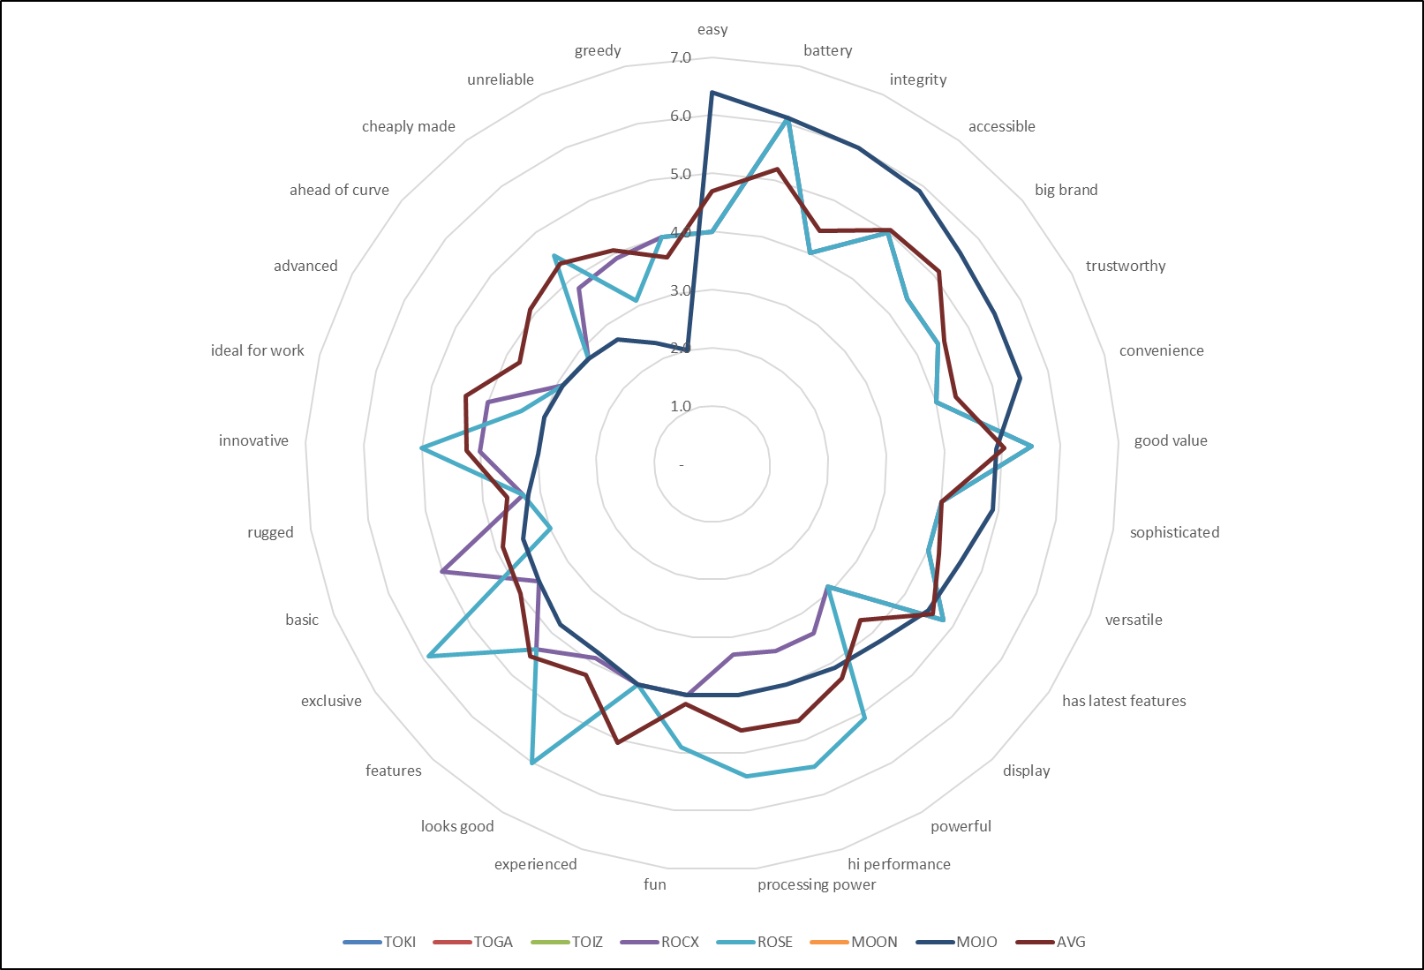
MOJO
ROSE
Notes:
Again we can check on the radar chart – MOON = dark blue, ROSE – light blue

Slide 18
Identify OWNED and SHARED attributes
MOJO vs ROSE
Notes:
Now we go back to the map to compare using the light/dark blue circles – that's why ROSE is slightly to the right

Slide 19
Identify OWNED and SHARED attributes
MOON
Notes:
And we continue by looking at MOON

Slide 20
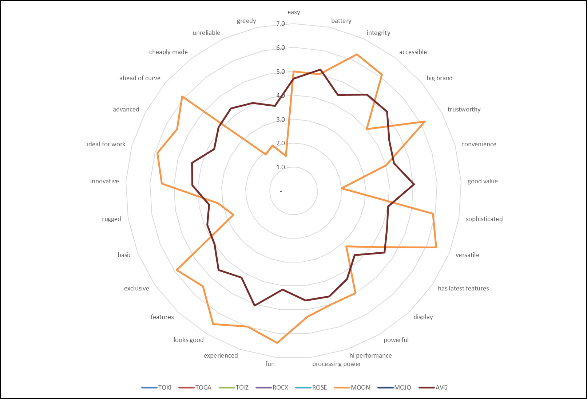
Data Check
MOON vs average brand
NOTE: A strong brand, but the most logical one to attack
Notes:
Let’s check MOON on the radar chart – they are the brand most at risk

Slide 21
Look for More Insights
Analyzing MDS Maps
Descriptive
Exploratory
Notes:
We have been mainly descriptive – let’s start to explore the market and look for insights

Slide 22
Identify dimensions
This is a more challenging , and more subjective part, of the analysis
Identifying dimensions
Labelling them
Using them in decisions
Takes time, knowledge of the market, and some map variations may help
Notes:
Firstly we can identify dimensions – this is challenging and subjective

Slide 23
Identify dimensions
CAPABILITY
Notes:
First dimension = features + performance to cheap and basic

Slide 24
Identify dimensions
CAPABILITY
INTEGRITY/TRUST
Notes:
2nd dimension = from integrity and trust to unreliable and greedy

Slide 25
Identify dimensions
CAPABILITY
INTEGRITY/TRUST
INNOVATION
Notes:
3rd dimension = from easy to latest features to ahead of the curve

Slide 26
Other Insights?
Notes:
Let’s look for what other insights we can find…

Slide 27
Other Insights?
Consumers perceive price = value,
not features = value
Notes:
Let’s look at GOOD VALUE = market equates value as low price

Slide 28
Other Insights?
And consumers understand that price = low quality, but not a barrier?
Consumers perceive price = value,
not features = value
Notes:
But consumers recognise that a low price = basic – so no barrier/hurdle to purchase

Slide 29
Other Insights?
Brands are shared, or not strongly associated, with other attributes
Connected and disconnected attributes
Incongruent attributes
Notes:
Let’s look at related and unrelated attributes – brand does fit to other attributes TO good value is not equated to ahead of the curve

Slide 30
Other Insights?
Business markets = ideal for work
High quality features are important!
Notes:
Ideal for work is associated with performance and features = a business market

Slide 31
Other Insights?
CAPABILITY
INTEGRITY/TRUST
Correlated attributes
Notes:
These two dimensions are correlated – sort of parallel or moving in the same direction

Slide 32
MDS Analysis RECAP
Identify competitor sets
Identify related attributes, as perceived by consumers
Identify OWNED and SHARED attributes
  = overall positioning ➔ points-of-parity and points-of-difference
Identify dimensions and label/describe
Notes:
Let’s recap these four points

Slide 33
MDS Analysis RECAP
Identify competitor sets
Identify related attributes, as perceived by consumers
Identify OWNED and SHARED attributes
  = overall positioning ➔ points-of-parity and points-of-difference
Identify dimensions and label/describe
Look for other insights
  Correlated dimensions
  Incongruent attributes
  Appropriate attribute selection
IMPORTANT: Compare back to the data to confirm your analysis
Notes:
And we can identify new insights

Slide 34
Quick Note: MDS vs Cluster Analysis
MDS maps rely on related connections
  Brands vs brands
  Brands vs attributes
  Attributes vs attributes
Notes:
These maps require perception data where there are interrelationships

Slide 35
Quick Note: MDS vs Cluster Analysis
MDS maps rely on related connections
  Brands vs brands
  Brands vs attributes
  Attributes vs attributes
If you are looking to classify or summarise a market:
  Segments, key customers, key players
Then MDS is probably not the tool, you are looking for clusters/segments
So check out… www.clusteranalysis4marketing.com
Notes:
If you are looking to segment or classify – then perhaps use the cluster template at this site

Slide 36

Understanding MDS Perceptual Maps
Presented by
Geoff Fripp
Notes:
Hope that adds to your tools for marketing

